Slide 1
CS118 – Programming Fundamentals
Lecture # 20
Tuesday, October 30, 2019
FALL 2019
FAST – NUCES, Faisalabad Campus
Course Instructor:
Ebad Majeed
Slides Credit:
Rizwan Ul Haq

Slide 2
Local and Global Variables
Local variable: Defined within a function or block; accessible only within the function or block
Other functions and blocks can define variables with the same name
When a function is called, local variables in the calling function are not accessible from within the called function
C++ does not allow the nesting of functions. That is, you cannot include the definition of one function in the body of another function.

Slide 3
Local and Global Variables
Global variable: A variable defined outside all functions; it is accessible to all functions within its scope
Easy way to share large amounts of data between functions
Scope of a global variable is from its point of definition to the program end
Use cautiously

Slide 4
Local Variable Lifetime
A local variable only exists while its defining function is executing
Local variables are destroyed when the function terminates
Data cannot be retained in local variables defined in a function between calls to the function

Slide 5
Initializing Local and Global Variables
Local variables must be initialized by the programmer
Global variables are initialized to 0 (numeric) or NULL (character) when the variable is defined

Slide 6
Local and Global Variable Names
Local variables can have same names as global variables
When a function contains a local variable that has the same name as a global variable, the global variable is unavailable from within the function
The local definition "hides" or "shadows" the global definition

Slide 7
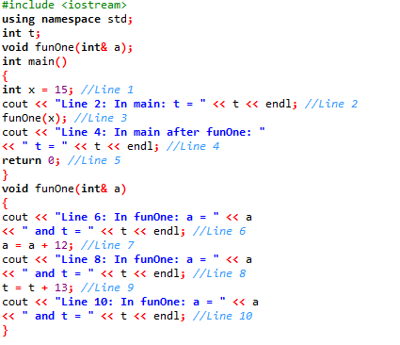

If Local and Global Variable have different name

Slide 8
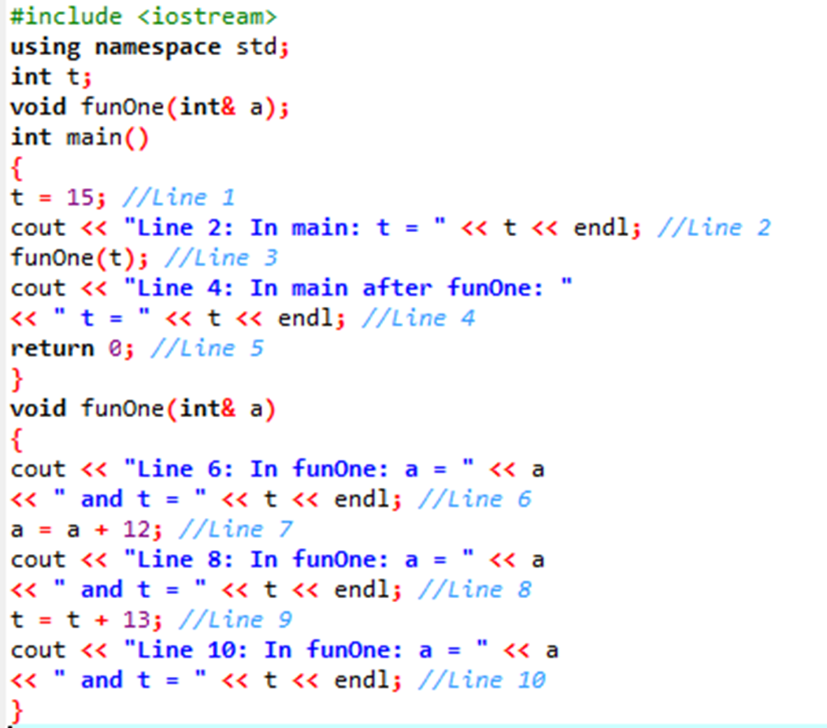

If Local and Global have same name

Slide 9
Static Local Variables
Local variables
Only exist while the function is executing
Are redefined each time function is called
Lose their contents when function terminates
static local variables
Are defined with key word static
static int counter;
Are defined and initialized only the first time the function is executed
Retain their contents between function calls
Better to initialize when declared
static int counter = 0 ;

Slide 10
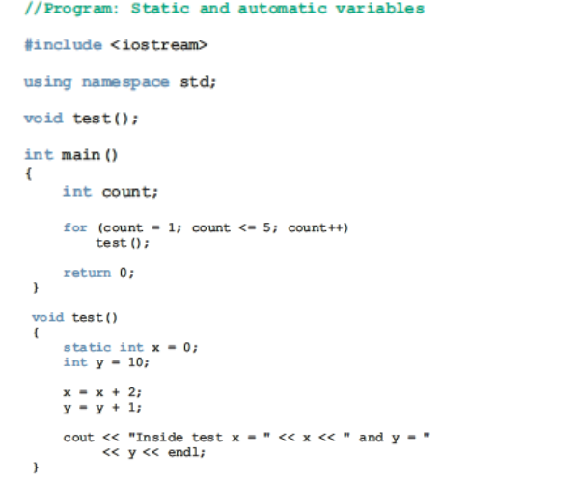
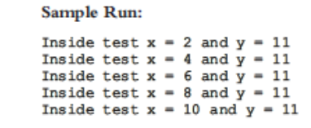
static variable illustrated

Slide 11
Default Arguments
Values passed automatically if arguments are missing from the function call
Must be a constant declared in prototype
void evenOrOdd(int = 0);
Multi-parameter functions may have default arguments for some or all of them
int getSum(int, int=0, int=0);
If you specify a value to default parameter then it will be used otherwise default value will be used

Slide 12
Default Arguments
If not all parameters to a function have default values, the ones without defaults must be declared first in the parameter list
int getSum(int, int=0, int=0); // OK
int getSum(int, int=0, int); // wrong!
When an argument is omitted from a function call, all arguments after it must also be omitted
sum = getSum(num1, num2); // OK
sum = getSum(num1, , num3); // wrong!
Constant value can’t be assigned to reference parameter
void func(int x, int& y=16, double z=34);

Slide 13
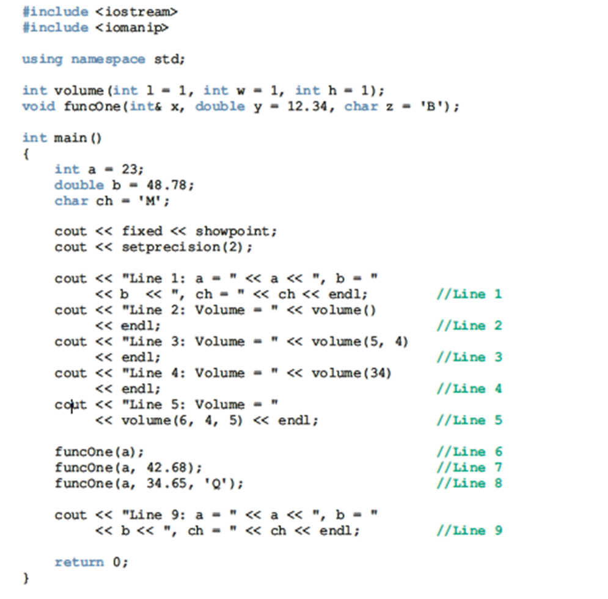

Slide 14
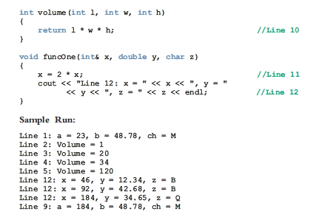

Slide 15
Overloading Functions
Overloaded functions are two or more functions that have the same name, but different parameter lists
Can be used to create functions that perform the same task, but take different parameter types or different number of parameters
Compiler will determine which version of function to call by argument and parameter list
Important thing is Formal parameter should be different either their datatype, number or position

Slide 16
Overloaded Functions - Examples
If a program has these overloaded functions:
int getDimensions(int) // 1
int getDimensions(int, int) // 2
int getDimensions(int, double) // 3
int getDimensions(double, double) // 4
The compiler will use them as follows:
int length, width;
double base, height;
getDimensions(length); // 1
getDimensions(length, width); // 2
getDimensions(length, height); // 3
getDimensions(height, base); // 4

Slide 17
Overloaded Functions - Examples
void functionXYZ()
void functionXYZ(int x, double y)
void functionXYZ(double one, int y)
void functionXYZ(int x, double y, char ch)
Consider the following function headings to overload the function functionABC:
void functionABC(int x, double y)
int functionABC(int x, double y)

Slide 18
The exit() Function
Terminates execution of a program
Can be called from any function
Can pass a value to operating system to indicate status of program execution
Usually used for abnormal termination of program
Requires cstdlib header file

Slide 19
What will be the output of the following Program’s ?

Slide 20


Slide 21
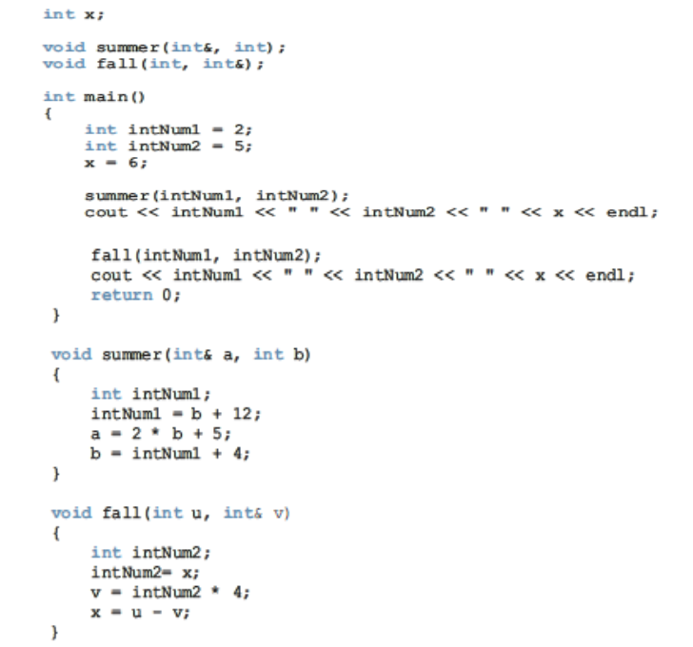


Slide 22
Summary
Functions (modules) are miniature programs
Divide a program into manageable tasks
C++ provides the standard functions
Two types of user-defined functions: value-returning functions and void functions
Variables defined in a function heading are called formal parameters
Expressions, variables, or constant values in a function call are called actual parameters

Slide 23
Summary (cont'd.)
In a function call, the number of actual parameters and their types must match with the formal parameters in the order given
To call a function, use its name together with the actual parameter list
Function heading and the body of the function are called the definition of the function
A value-returning function returns its value via the return statement

Slide 24
Summary (cont'd.)
A prototype is the function heading without the body of the function; prototypes end with the semicolon
Prototypes are placed before every function definition, including main
User-defined functions execute only when they are called
In a call statement, specify only the actual parameters, not their data types

Slide 25
Questions

